Slide 1
Linear models in R
With categorical explanatory variables

Slide 2
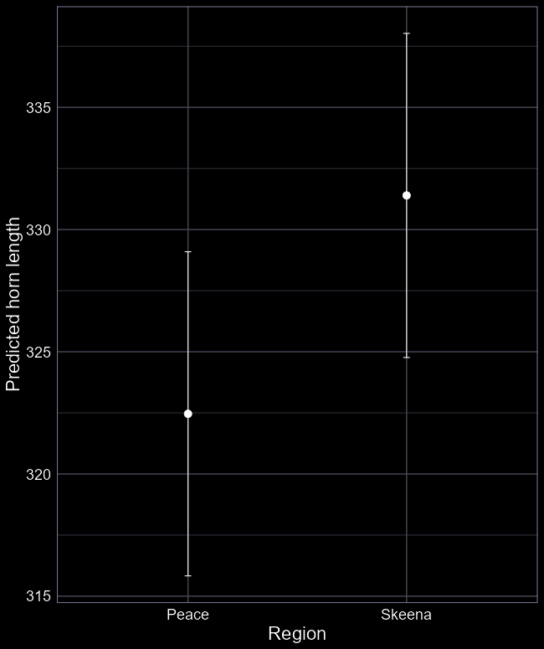

From theory to implementation

Slide 3
The core function
We continue using the same function from last week
lm()
We need to give the function specific information
The dataset
The model formula

Slide 4
Step 1: The data

Slide 5
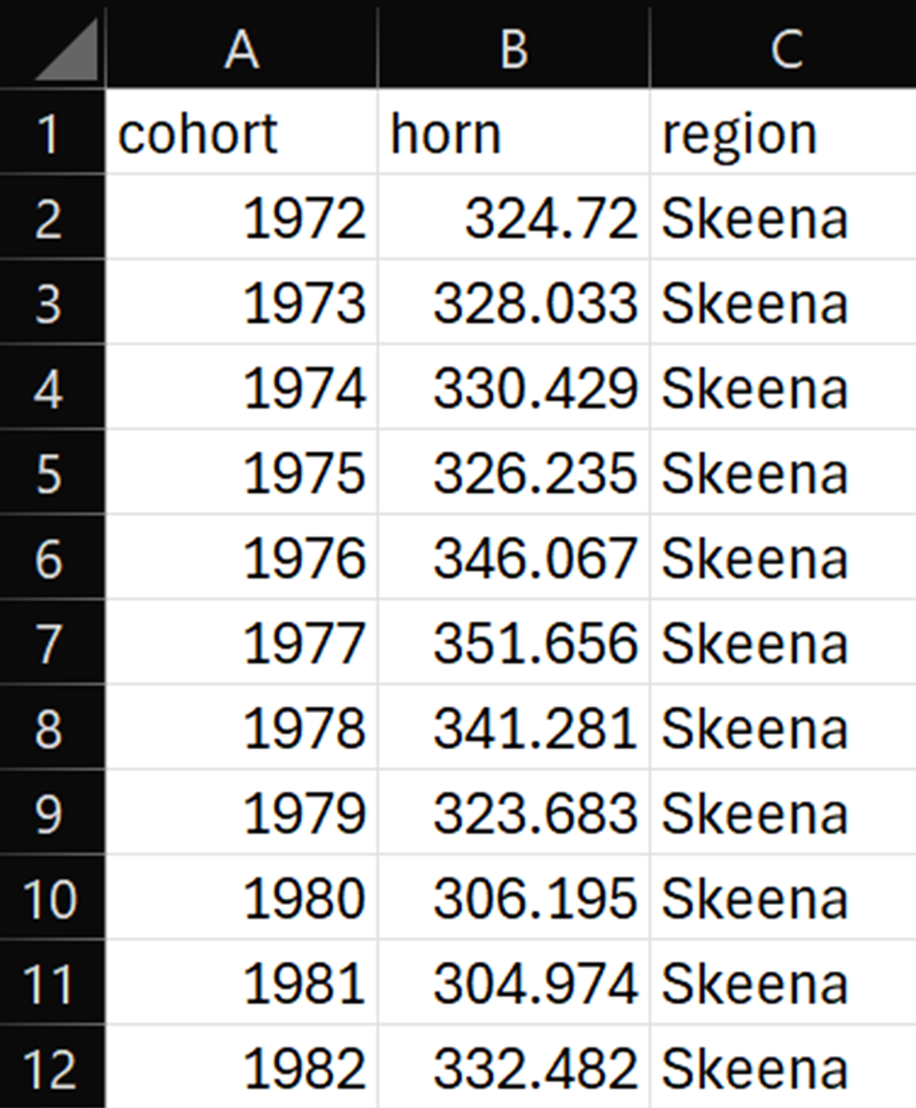
Make sure your data is ready
We want the data in “tabular” form
Where:
each row is an observation
each column is a variable

Slide 6
Step 2: The formula

Slide 7
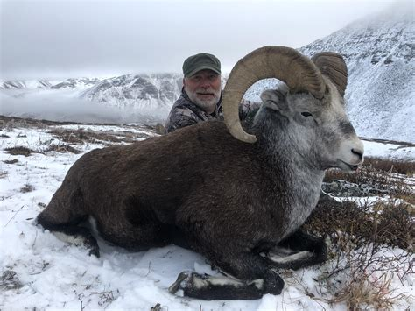
Model formula
We want to understand if average horn length is different in the two regions
Response variable = horn length
Explanatory variable = region
To convey this to lm():
horn ~ region
In English: “Horn length as a function of region”
In actual English: “Horn length is different in the two regions”

Slide 8
Running the model
We ask the model to find the average horn length in the two regions
Run a linear model
Call the stored output “shp_model”
There is more information
shp_model <- lm(horn ~ region,
data = shp_data)
Store the results
Use the “shp_data” dataset

Slide 9
Step 3: Interpret results

Slide 10

Now what?
We don’t do stats for the sake of it
We’re trying to learn
Our current model has two parameters we want to learn
Intercept ($β_{0}$)
Difference from $β_{0}$ ($β_{1}$)
How do we get that information?

Slide 11
summary(shp_model)
Call:
lm(formula = horn ~ region, data = df)
Residuals:
Min 1Q Median 3Q Max
-46.09 -10.69 -2.81 11.82 44.28
Coefficients:
Estimate Std. Error t value Pr(>|t|)
(Intercept) 322.462 3.383 95.326 <2e-16 ***
regionSkeena 8.933 4.784 1.867 0.0671 .
---
Signif. codes: 0 ‘***’ 0.001 ‘**’ 0.01 ‘*’ 0.05 ‘.’ 0.1 ‘ ’ 1
Residual standard error: 18.22 on 56 degrees of freedom
Multiple R-squared: 0.05862, Adjusted R-squared: 0.04181
F-statistic: 3.487 on 1 and 56 DF, p-value: 0.06709
Which model this is
Simple description of residuals
The biologically important parameter estimates

Slide 12
Done?
Estimate Std. Error
(Intercept) 322.462 3.383
regionSkeena 8.933 4.784

Slide 13
Step 4: Plot results

Slide 14
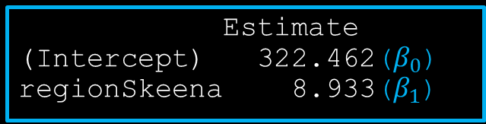

Our objective to make the figure
$$μ=β_{0}+β_{1}×Skeena$$
We can get these by doing: summary(shp_model)
Estimate
(Intercept) 322.462($β_{0}$)
regionSkeena 8.933($β_{1}$)

Slide 15

Our objective to make the figure
We just need values to plug in here
$$μ=322.5+8.9×Skeena$$

Slide 16

Making up data
We want a simple list of all values of region
R is excellent at doing this
We can use the c() function
c() for “combine”
region <- c(“Skeena”, “Peace”)
Creates a variable with just two values, Peace and Skeena.

Slide 17


Our objective to make the figure
$$μ=322.5+8.9×Skeena$$
But we’re back to multiplying 8.9 by “Skeena”. Why?
Because we want to avoid having to do this by hand:
$$Lower 95\% CI=(β_{0}−SE×1.96)+(β_{1}−SE×1.96) ×Skeena_{i}$$
$$Upper 95\% CI=\left(β_{0}+SE×1.96\right)+(β_{1}+SE×1.96) ×Skeena_{i}$$

Slide 18
The code
# Create fake data (and put in data frame)
nu_data <- data.frame(region = c("Skeena", "Peace"))
# Use predict function to apply equation
prds <- predict(m1, nu_data, se.fit = TRUE)
# Extract the average fit for each region
nu_data$fit <- prds$fit
# Get upper and lower 95% confidence intervals
nu_data$low <- prds$fit - prds$se.fit * 1.96
nu_data$upp <- prds$fit + prds$se.fit * 1.96
# Results in a dataset called nu_data: region fit low upp
1 Skeena 331.3949 324.7648 338.0251
2 Peace 322.4617 315.8315 329.0918

Slide 19
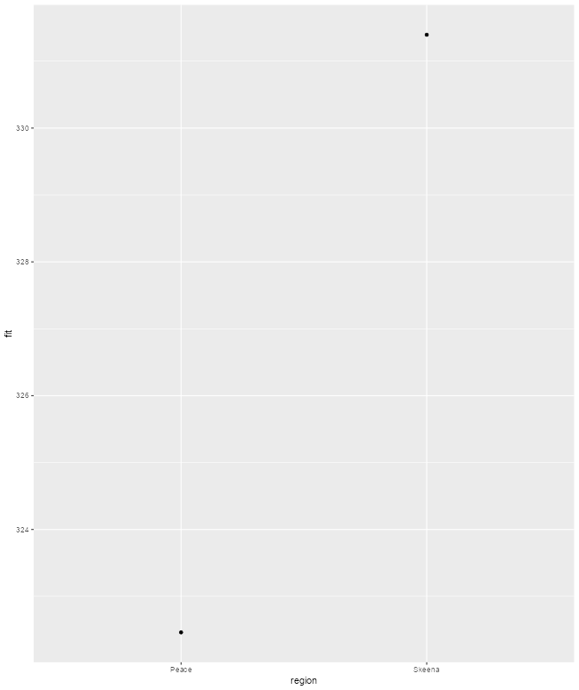
ggplot
ggplot(nu_data) +
geom_point(aes(x = region,
y = pred_fit))

Slide 20
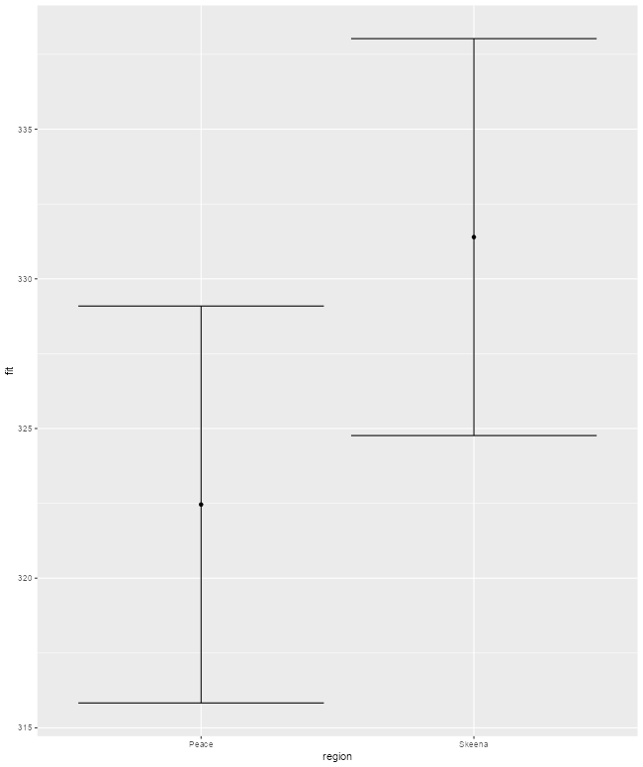
ggplot
ggplot(nu_data) +
geom_point(aes(x = region,
y = pred_fit)) +
geom_errorbar(aes(x = region,
ymin = low,
ymax = upp))

Slide 21
tl;dr
Actually fitting models in R is easy
Ensure data is in tabular form
Get the formula that captures your question
lm() handles all of the theory
Use summary() to extract the parameter estimates
Report the estimates!
Create a simple version of your explanatory variable
Use predict() to generate fitted values
Plot them using your software of preference

